Slide 1
“The Best War Map Ever Made”
Ezra Carman & the Atlas of the Battlefield of Antietam
by
Jamesina Thatcher
December 2013

Slide 2
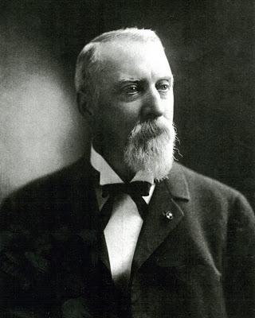
Ezra Carman
m
Figure 1

Slide 3
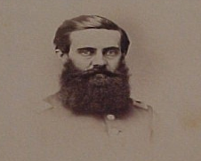
John C. Stearns
Figure 2

Slide 4
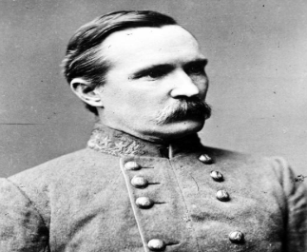
Henry Heth
Figure 3

Slide 5
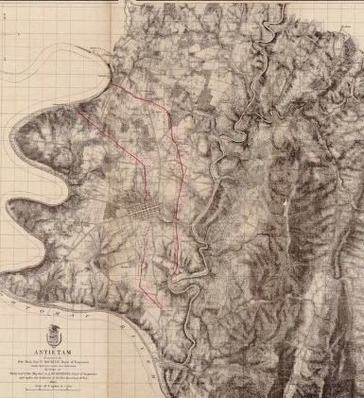
Michler Map
1867
Figure 4

Slide 6
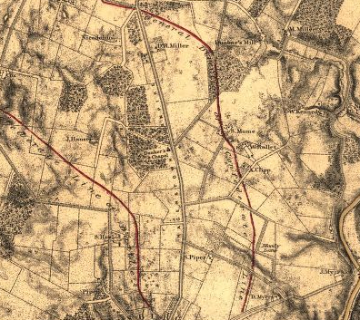
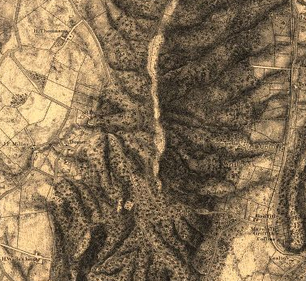
Hachure
Figure 5

Slide 7
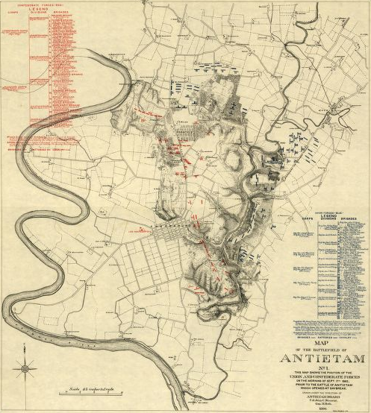
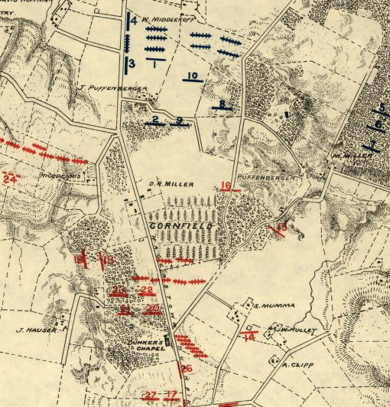
Stearns & Heth
Morning Lines, 1893
Figure 6

Slide 8
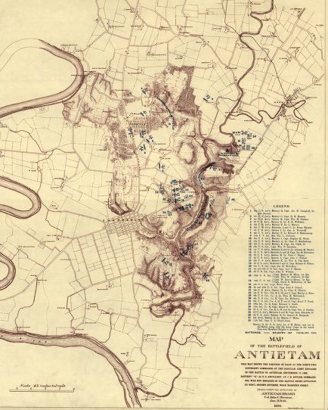
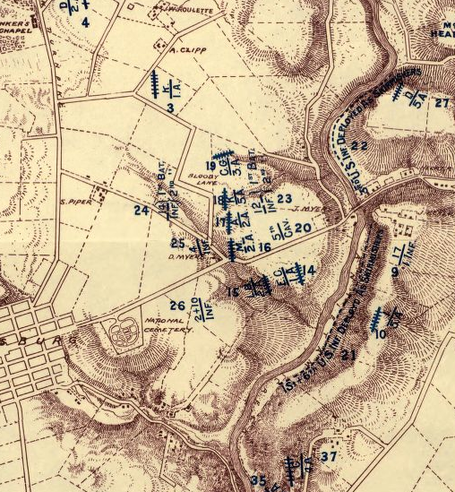
Stearns & Heth
Regular Army Positions, 1893
Figure 7

Slide 9
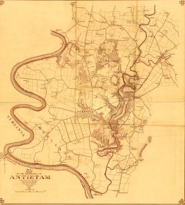
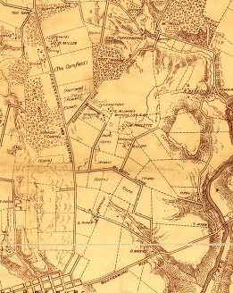
Stearns & Heth
Antietam Base Map, 1894
Figure 8

Slide 10
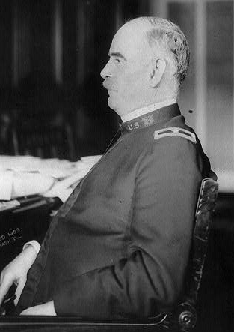
George B. Davis
Figure 9

Slide 11
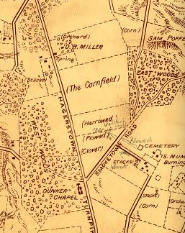
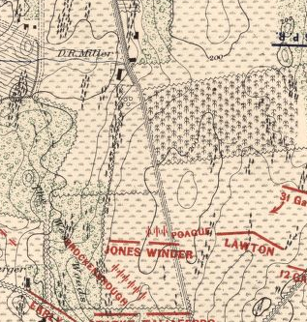
James M. Garrett
1894 & 1908
Figure 10

Slide 12
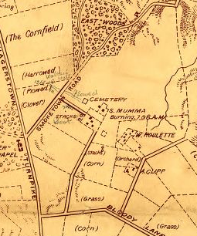
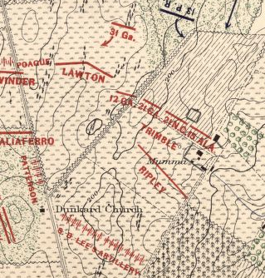
H.A. Brown
1894 & 1908
Figure 11

Slide 13
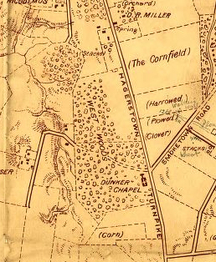
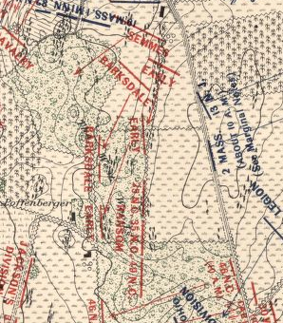
Jas. Dinkins
1894 & 1908
Figure 12

Slide 14
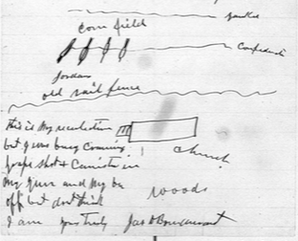
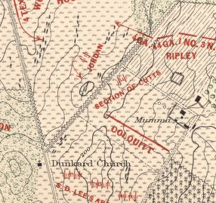
Jas. D. Bondurant
1899 & 1908
Figure 13

Slide 15
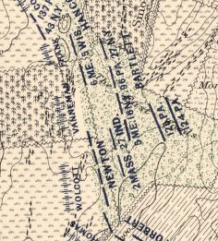
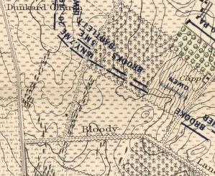
Frank Palmer, 1908
Position 1 & Position 2
Figure 14

Slide 16
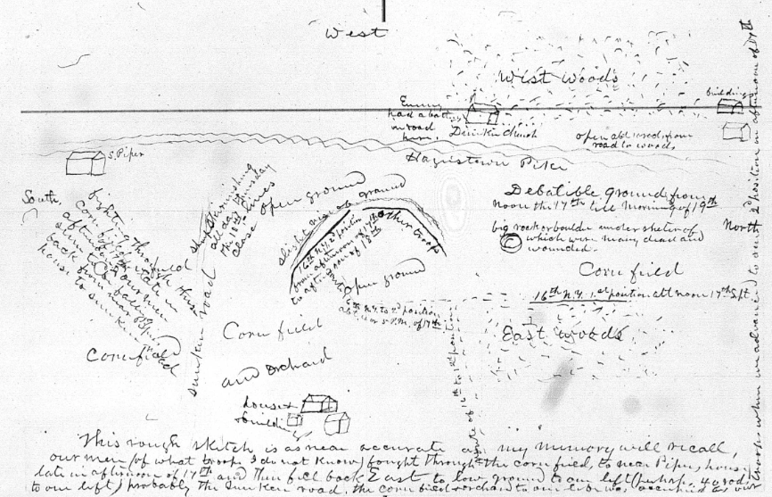
Frank Palmer
Sketch of Position 1 & 2
Figure 15

Slide 17
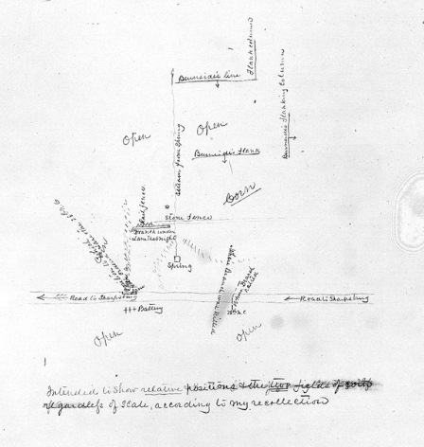
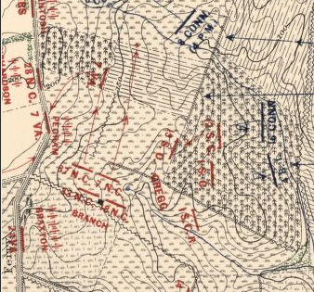
James Lane
1895 & 1908
Figure 16

Slide 18
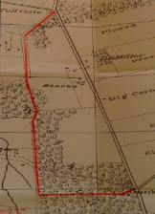
Confederate Avenue
Figure 17

Slide 19
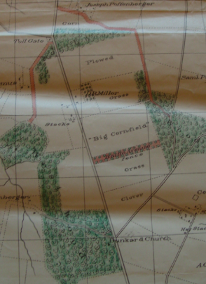
Hotchkiss
“Battle Avenue”
Figure 18

Slide 20
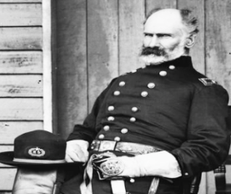
Marsena Patrick
Figure 19

Slide 21
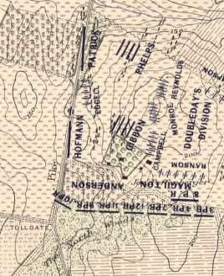
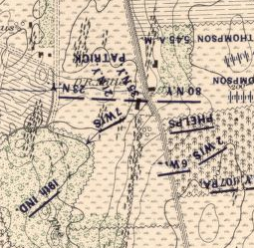
Patrick
Daybreak 6 to 6:20 AM
Figure 20

Slide 22
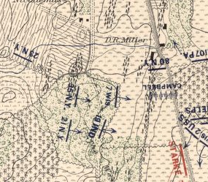
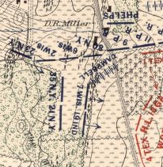
Patrick
6:45 to 7 AM 7:20 AM
Figure 21

Slide 23
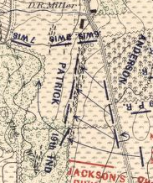
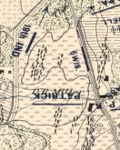
Patrick
7:30 AM 8 AM
Figure 22

Slide 24
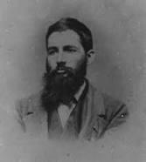
Jed Hotchkiss
Figure 23

Slide 25
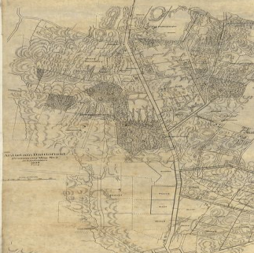
Hotchkiss
Preliminary Map No. 3, 1895
Figure 24

Slide 26
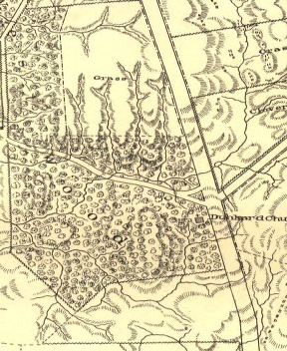
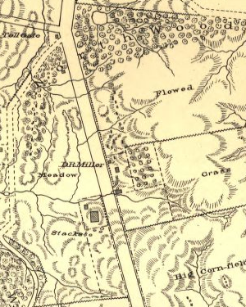
Hotchkiss
Preliminary Map No. 3, 1895
Figure 25

Slide 27
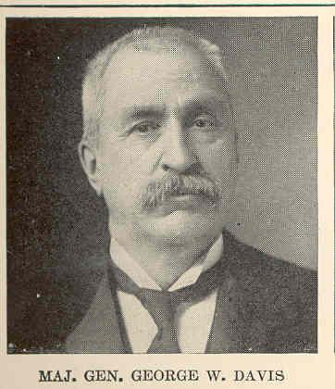
George W. Davis
Figure 26

Slide 28
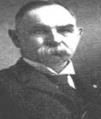
Emmor B. Cope
Figure 27

Slide 29
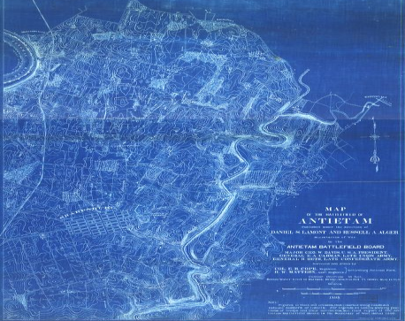
Cope
Blue print 1898
Figure 28

Slide 30
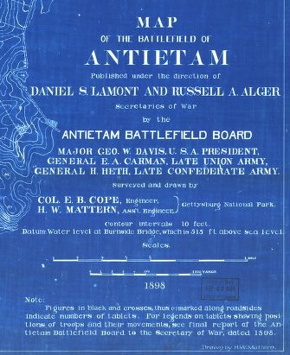
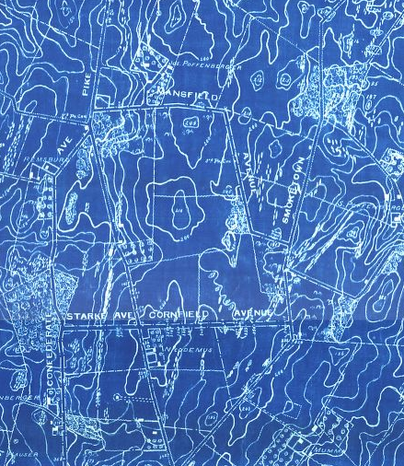
Cope
1898 Title & Contours
Figure 29

Slide 31
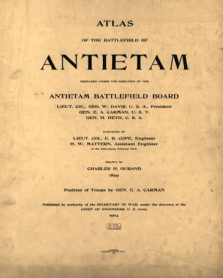
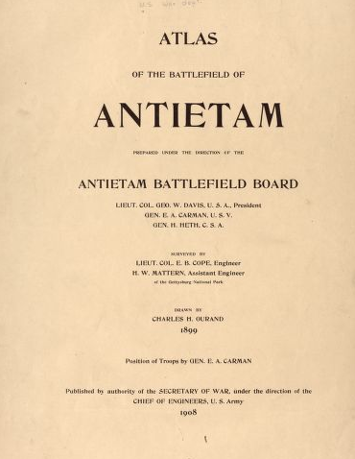
Atlas of the Battlefield of Antietam
1904 & 1908
Figure 30

Slide 32
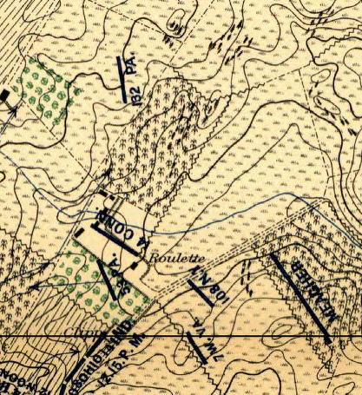
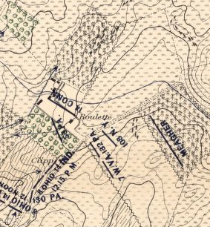
F.L. Hitchcock
1904 & 1908
Map No. 10
Noon to 12:15 PM
132nd PA Position Change
Figure 31

Slide 33
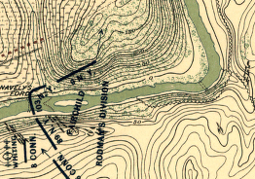
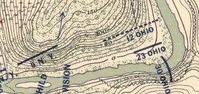
R.B. Wilson
1904 & 1908
Map No. 11
1 PM
12th OH Added
Figure 32

Slide 34


Jos. R.C. Ward
1904 & 1908
Map No. 8
9 to 9:30 AM
Howard’s Brigade Intact
Figure 33

Slide 35


J.C. Delaney
1904 & 1908
Map No. 3
6:45 to 7 AM
107th PA Added
Figure 34

Slide 36


Sylvester Byrne
1904 & 1908
Map No. 8
9 to 9:30 AM
72nd PA Position Change
Figure 35

Slide 37

Sylvester Byrne Map of 72nd PA Position
Figure 36

Slide 38


James Dinkins
1904 & 1908
Map No. 8
9 to 9:30 AM
Barksdale Brigade Not Changed
Figure 37

Slide 39


Fred Barger
1904 & 1908
Map No. 11
1 PM
Only 7th ME Position Change
Figure 38

Slide 40

Fred Barger Map of Irwin Brigade
Figure 39

